Slide 1

Il neige
It is snowing /
Mae’n bwrw eira!
(gallois “mine bu-roo ayra”)

Slide 2
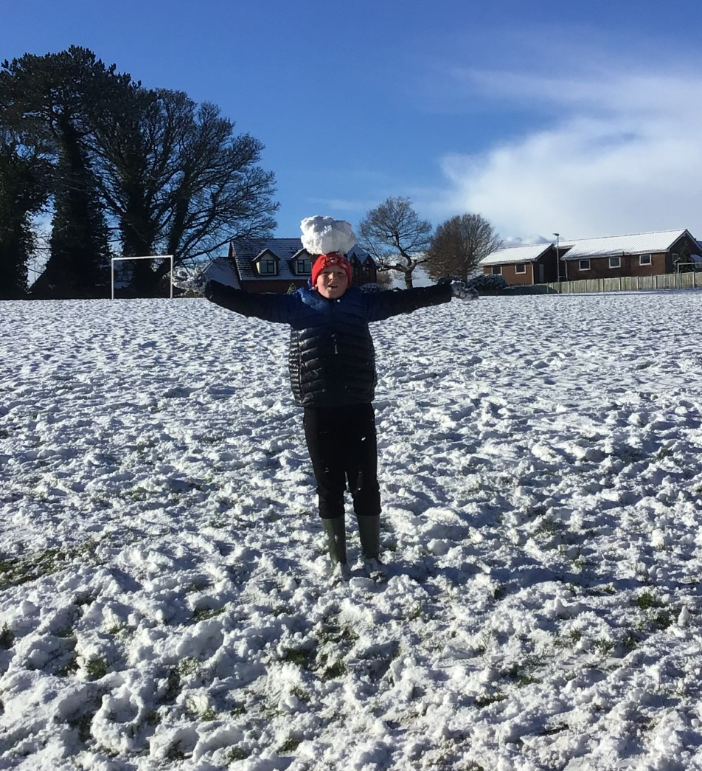
la neige / eira / snow

Slide 3
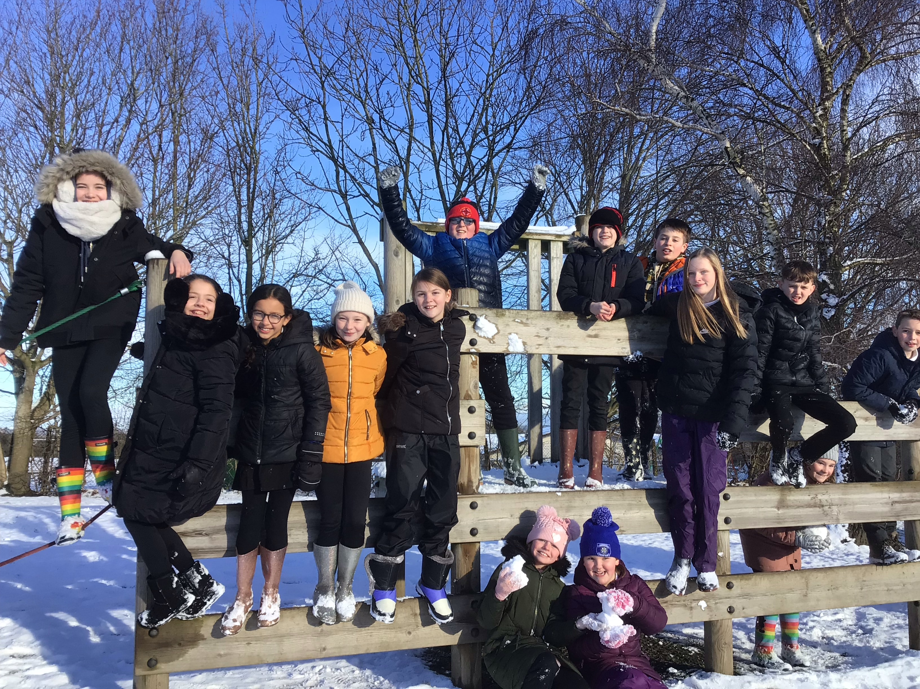
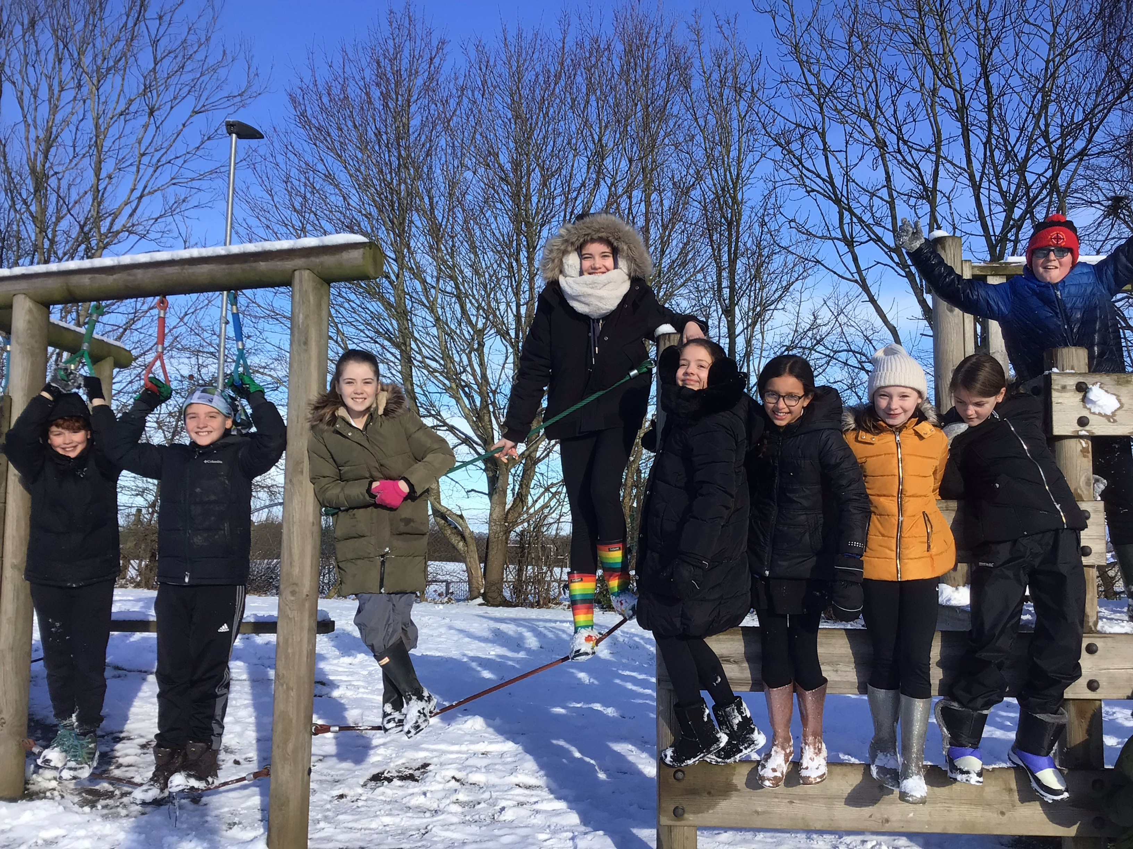
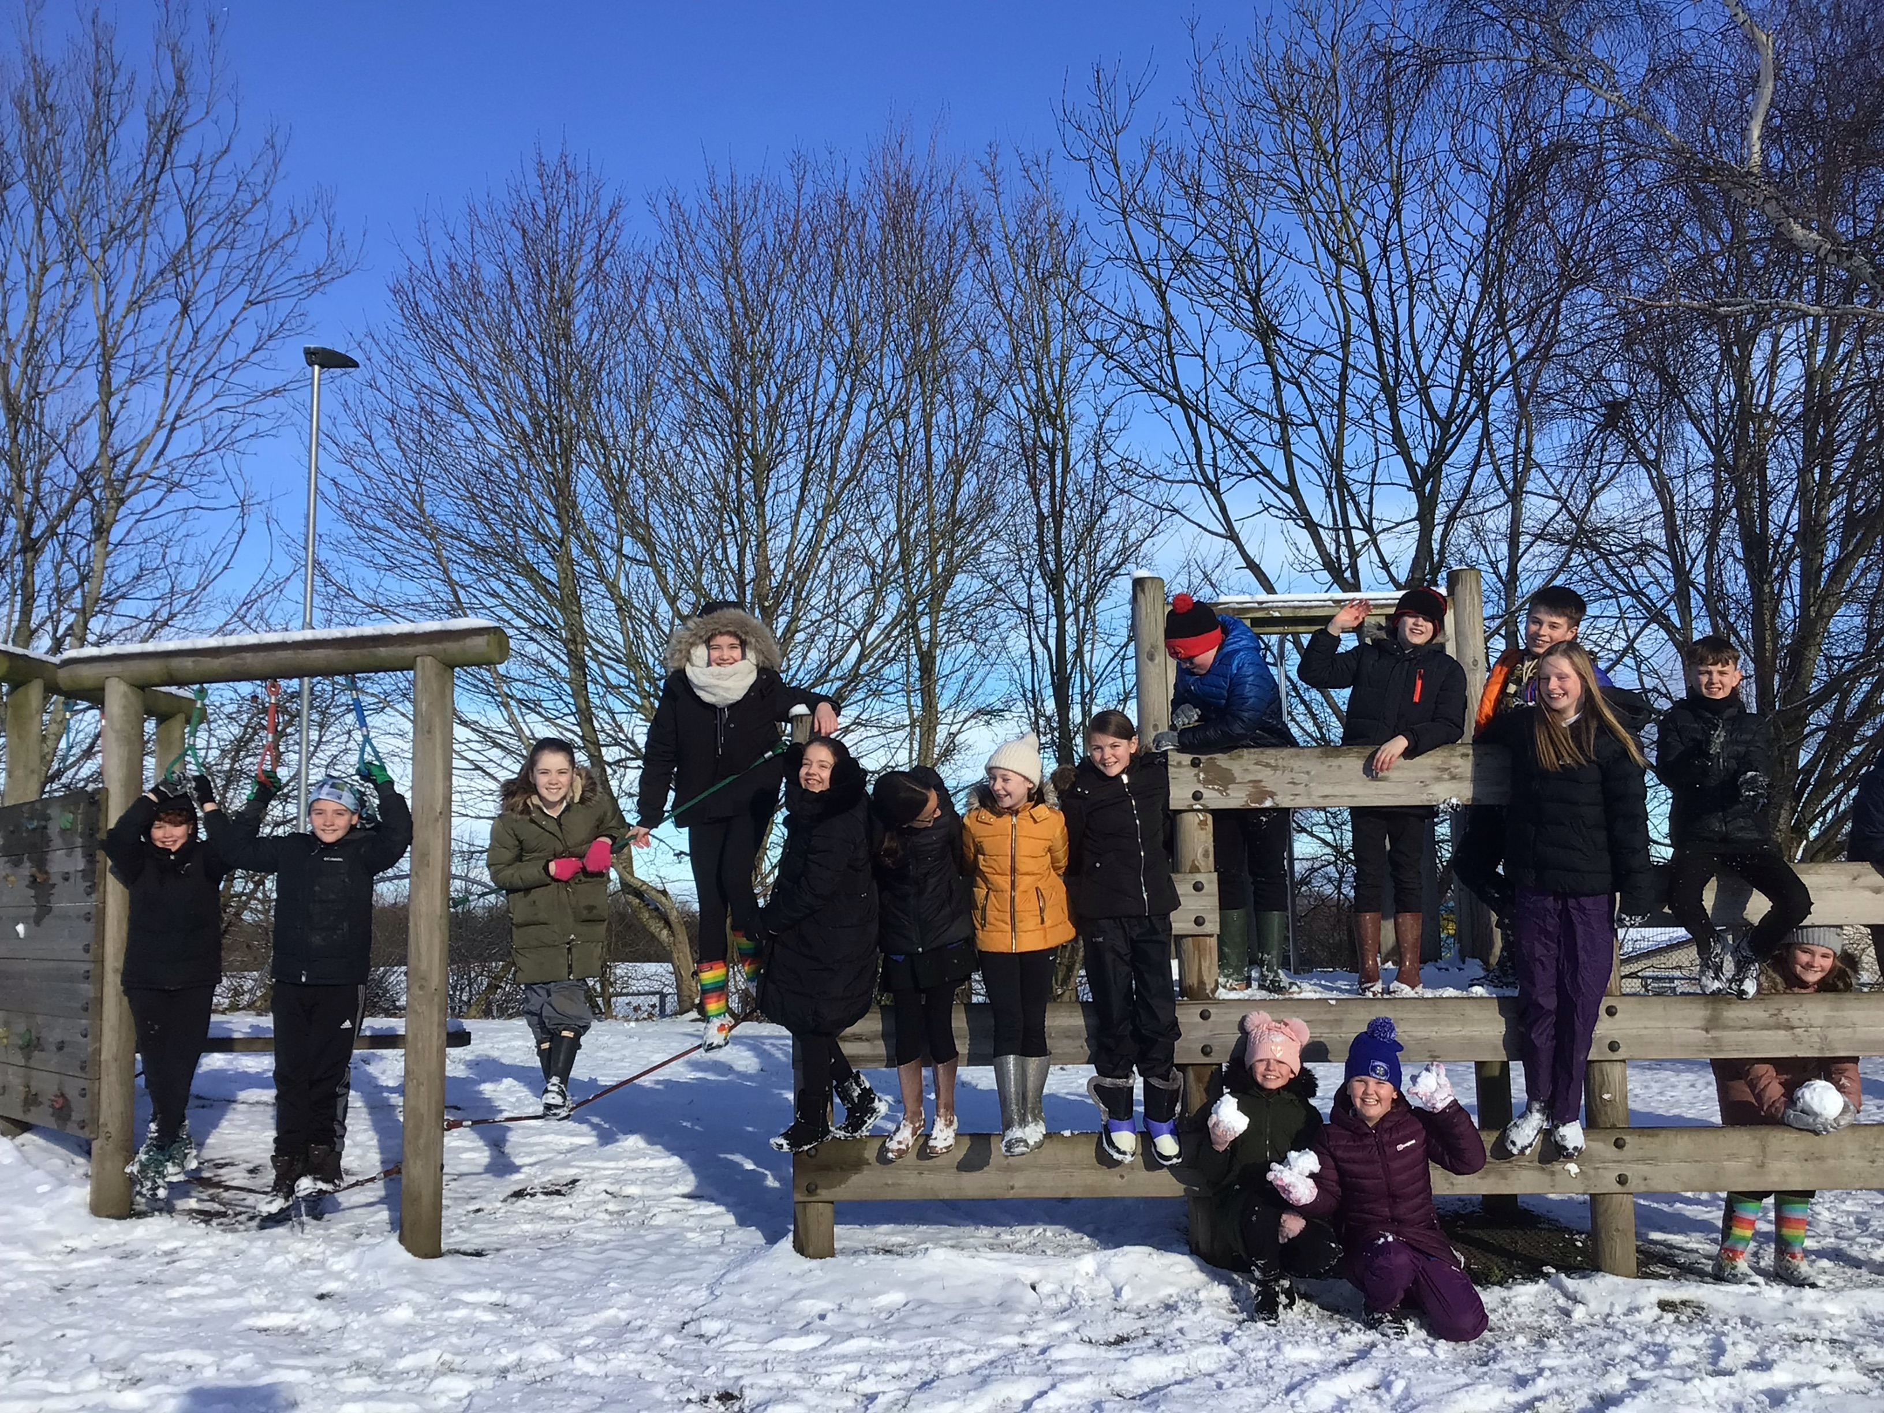
We love the snow! Nous adorons la neige!

Slide 4
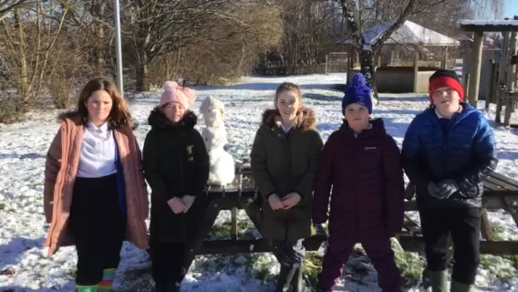
We tried very hard with new words!

